Slide 1
Vertical alignment
Taught by Yossef Ayman Zedan

Slide 2
Overview
Easily change the vertical alignment of inline, inline-block, inline-table, and table cell elements.
Change the alignment of elements with the vertical alignment utilities. Please note that vertical-align only affects inline, inline-block, inline-table, and table cell elements.
Choose from .align-baseline, .align-top, .align-middle, .align-bottom, .align-text-bottom, and .align-text-top as needed.
To vertically center non-inline content (like <div>s and more), use flex box utilities

Slide 3

With inline elements:
<span class="align-baseline">baseline</span>
<span class="align-top">top</span>
<span class="align-middle">middle</span>
<span class="align-bottom">bottom</span>
<span class="align-text-top">text-top</span>
<span class="align-text-bottom">text-bottom</span>

Slide 4
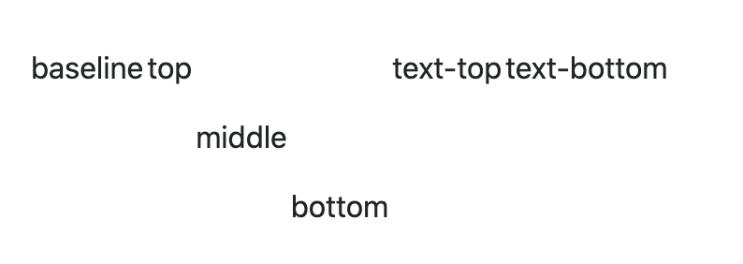
With table cells:
<table style="height: 100px;">
<tbody>
<tr>
<td class="align-baseline">baseline</td>
<td class="align-top">top</td>
<td class="align-middle">middle</td>
<td class="align-bottom">bottom</td>
<td class="align-text-top">text-top</td>
<td class="align-text-bottom">text-bottom</td> </tr> </tbody> </table>

Slide 5
With table cells:
<table style="height: 100px;">
<tbody>
<tr>
<td class="align-baseline">baseline</td>
<td class="align-top">top</td>
<td class="align-middle">middle</td>
<td class="align-bottom">bottom</td>
<td class="align-text-top">text-top</td>
<td class="align-text-bottom">text-bottom</td> </tr> </tbody> </table>

